Slide 1




KEYWORD EXTRACTION
Climate change Data
GROUP 1
Dr Lalita JosyulaLucky
Garima Jain
Antra
Shuaib Khassin
M Nithya kruthi

Slide 2

Agenda
What is keyword extraction?
Why is keyword extraction important?
What are the different methods of keyword extraction?
How to use it for Climate data?
Run the code

Slide 3


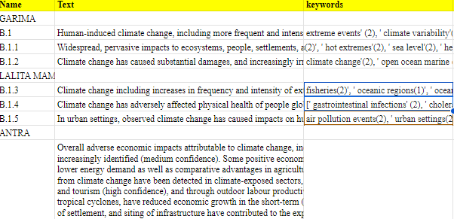

DATA

Slide 4


DISCUSSION
Explored the various packages available in python such as such as: Numpy,Pandas, transformers,,NLTK
Observed the qulaity of the keywords extracted.
Noticed the differences in the keywords generated through different methods
Performed the key word extraction for 2 sections of technical summary in IPCC reports

Slide 5

GRADING ANALYSIS

Slide 6
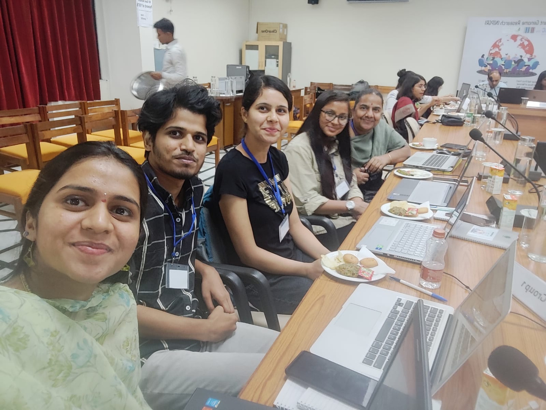

OUR TEAM
Back to Agenda Page

Slide 7
THANKYOU
Special thanks to karthik

